Slide 1

NUMLPay
One Click Solution

Slide 2
Presented By:
Abdul Hanan Nawaz (12335)
Muhammad Bakht Jamal(12384)
Muhammad Hamza (12376)
Supervisor
Sir Mohsin Abbas

Slide 3
Agenda
Introduction
Existing System
Problem Description
Proposed System
Features of Proposed System
Development Methodology
Resource Requirement
Hardware / Software Requirements
System Modeling
Work Accomplished/Screenshots/Videos

Slide 4
What is NUMLPay?
Educational institutions need efficient services for students, especially in tuition fee payments.
Traditional methods are time-consuming, inconvenient, and prone to errors.
Manual processing involves long lines and paperwork, challenging for large universities.
Modern fee payment systems offer convenience, efficiency, and accuracy.
They provide a secure online platform with various payment options and generate payment receipts.
Implementation enhances financial management, reduces errors, and streamlines payment for students.
Improves university reputation by offering modern, student-friendly services.
Benefits include convenient remote payments, reducing effort for universities.
Reduces manual errors, generates receipts, and maintains accurate payment records.

Slide 5
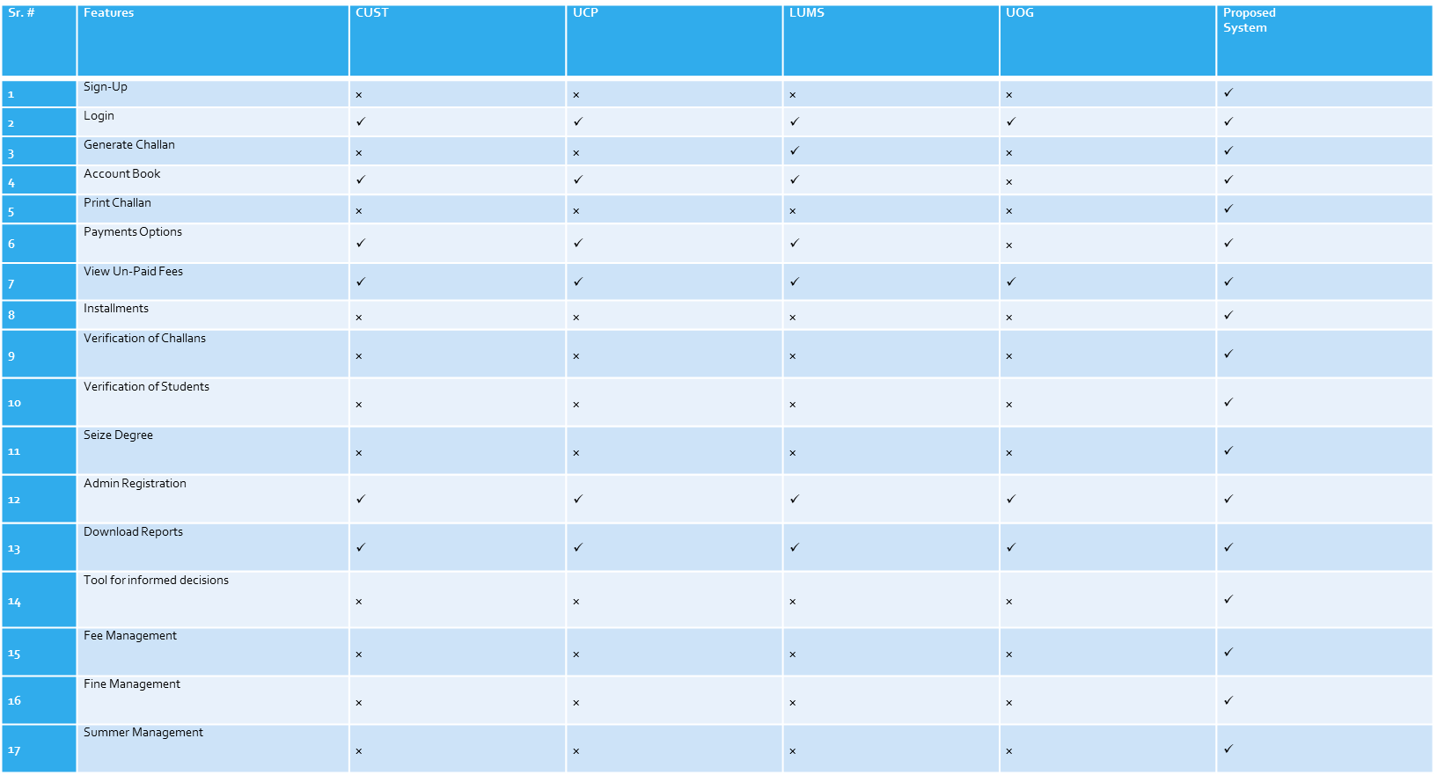
Existing System

Slide 6
Proposed Statement
Challenges with Traditional Methods:
Time-consuming and necessitates physical visits to payment centers.
Prone to human errors in manual payment management, leading to inaccuracies and reconciliation problems.
May result in financial disagreements and miscommunication between the university and students.

Slide 7
Continue…
NUMLPay Solutions:
Eliminates the need for physical visits to payment centers, making the process more convenient.
Streamlines fee payments, reducing hassle and processing times.
Automates payment processing, significantly reducing the likelihood of human errors in record-keeping.
Ensures precise financial reconciliation, minimizing discrepancies.
Promotes enhanced communication between students and the university by increasing transparency and reducing payment disparities.

Slide 8
Continue…
Purpose: Overcome limitations of existing payment systems.
Simplified Process: Streamlines fee payments, saving time and effort.
Accessibility: Available via Android and web systems.
Features:
Online fee payment options.
User-friendly support system.
Community Enhancement: Aims to improve fee payment experience for NUML community.

Slide 9
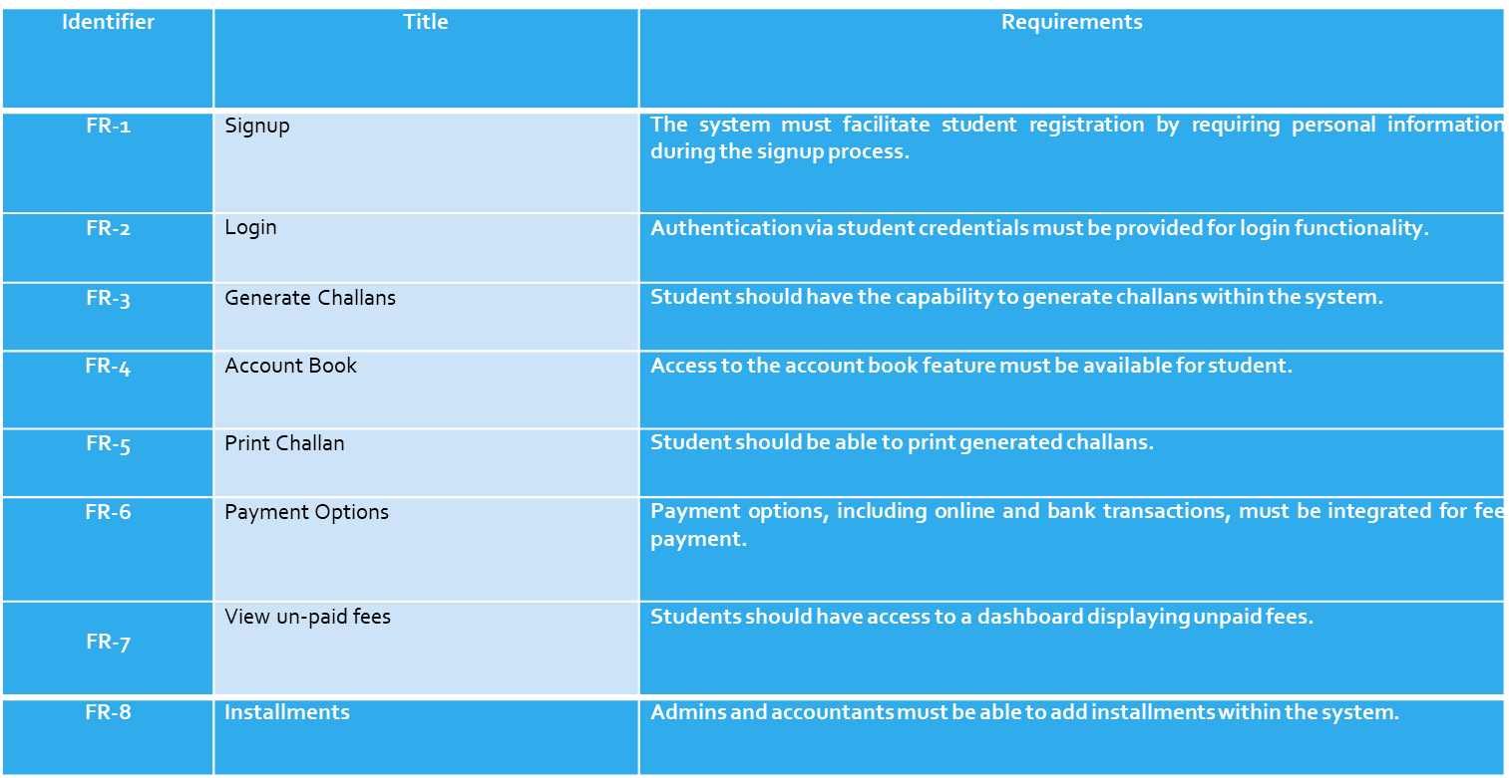
Proposed System Requirements

Slide 10
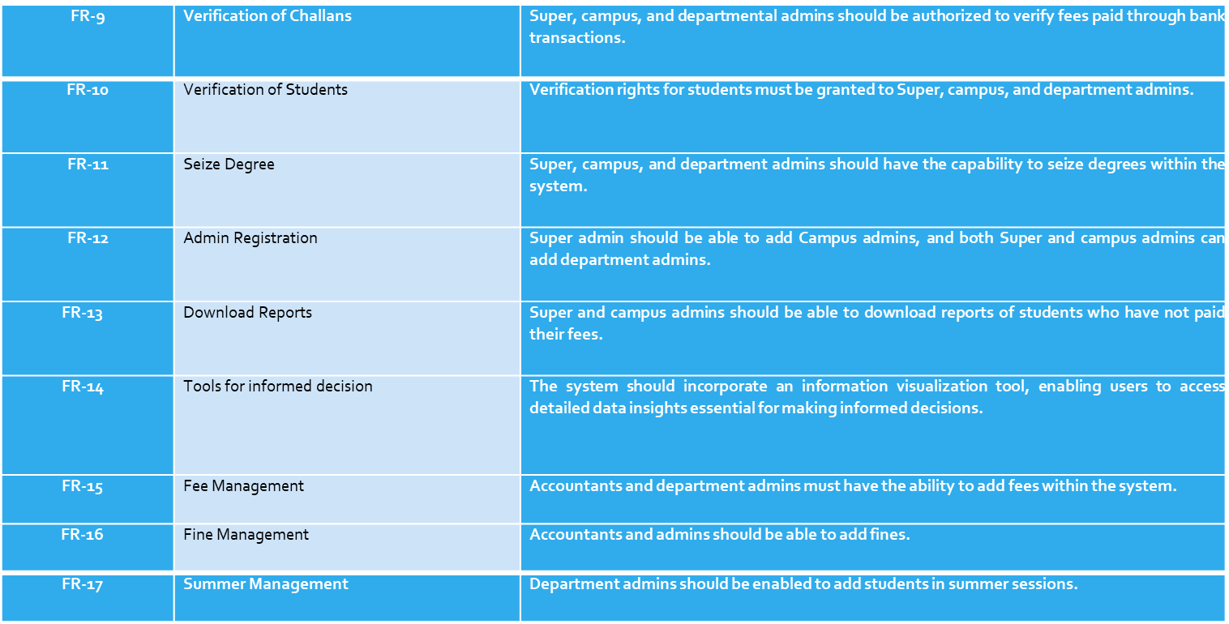
Continue…

Slide 11
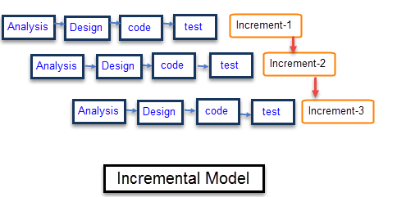
Methodology

Slide 12
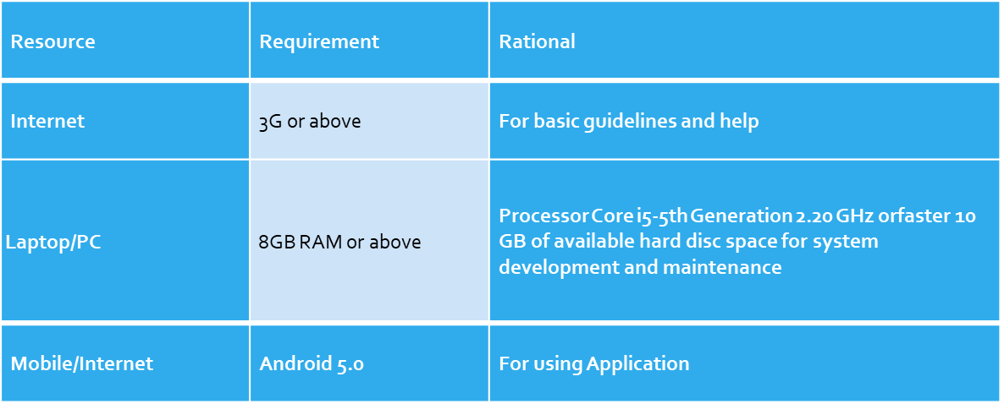
Resource Requirements

Slide 13
Hardware/Software Requirements
Hardware
Laptop or PC
Core i5 2.5 GHz of processor
Minimum of 8 GB RAM
SSD 256 GB
Window 10 or above
Hardware is needed for a program to function properly on a device
Mobiles that support Android
1.5 GHz of processor
Minimum of 4 GB RAM
Minimum of 32 GB of ROM

Slide 14

Hardware/Software Requirements
Software
Android Studio 2022.2.1 (for Windows)
Visual Studio 2022 (for Windows)
Sql Server Management Studio

Slide 15
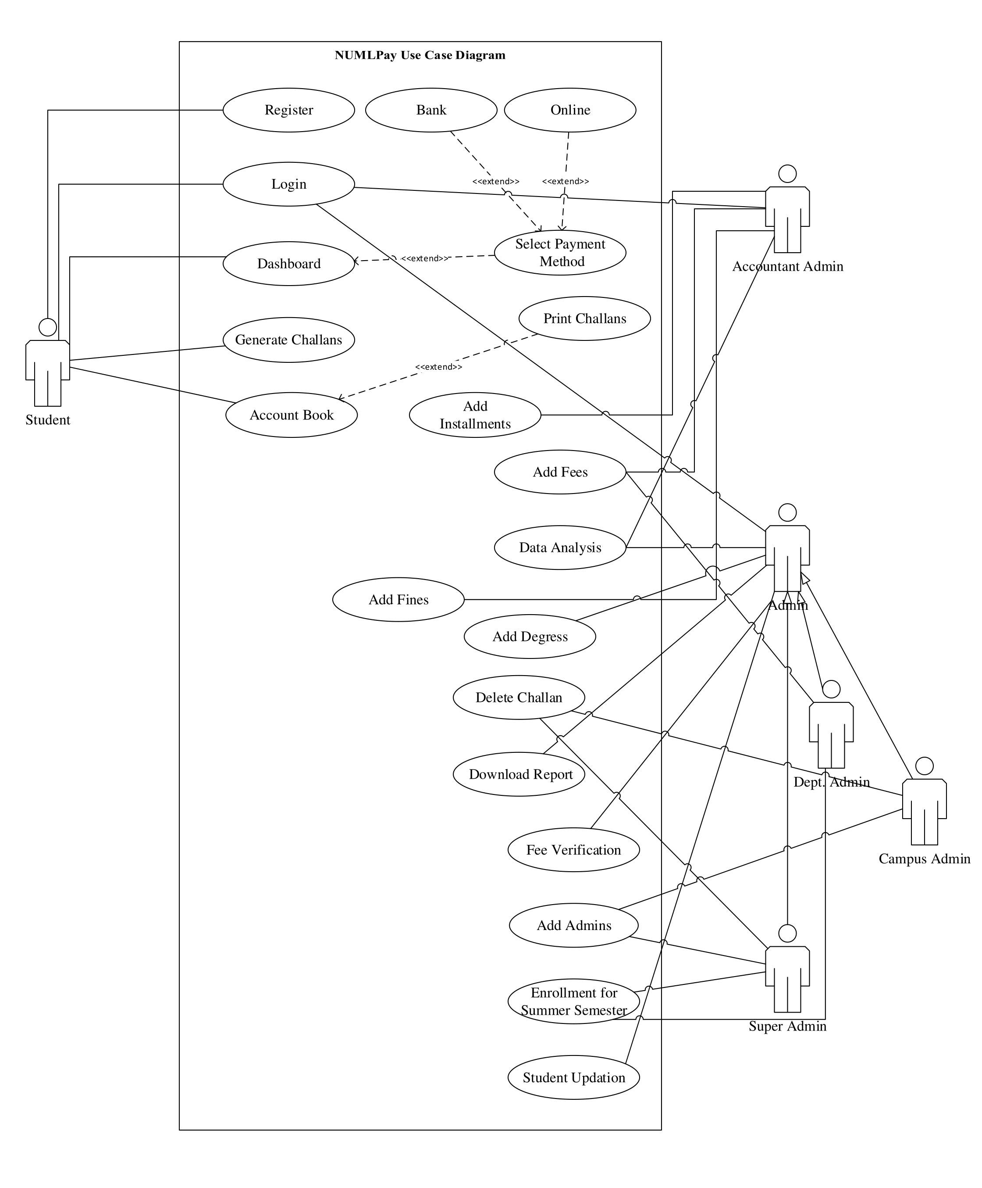
Use case Diagram

Slide 16
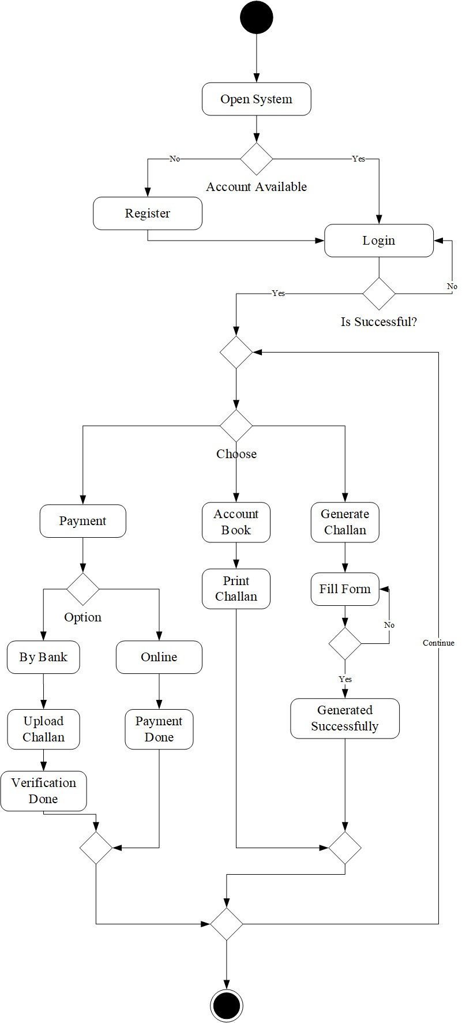
Activity Diagram For User

Slide 17
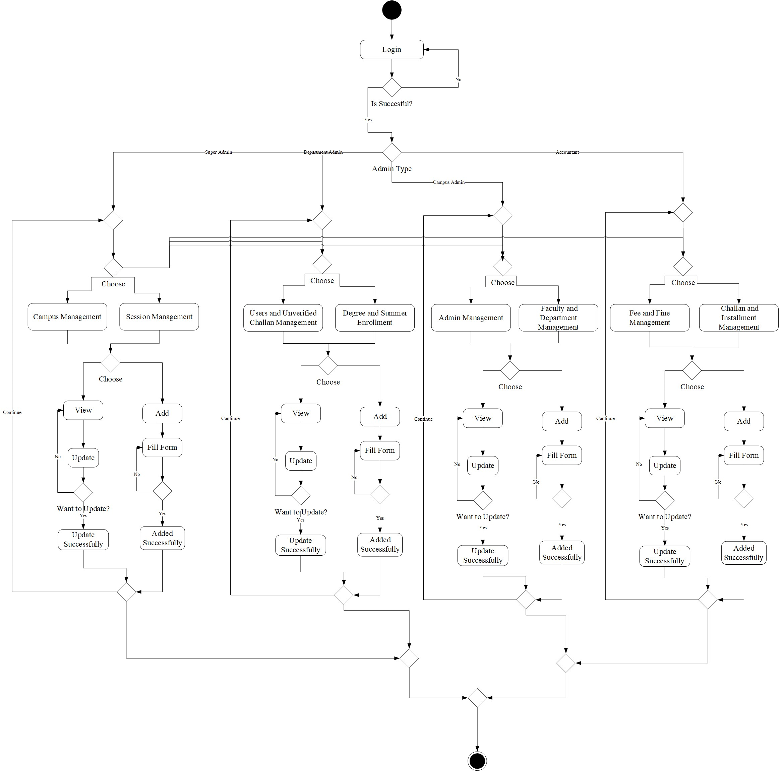
Activity Diagram For Admin

Slide 18
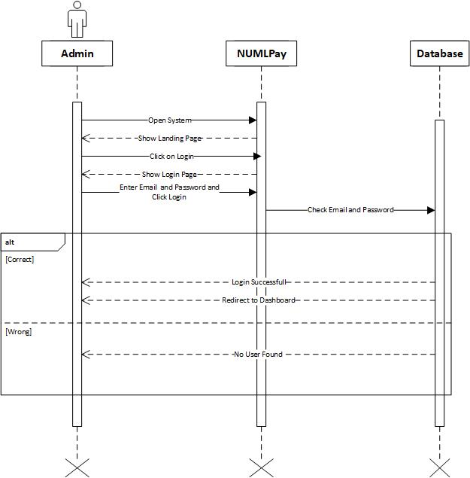
Login Sequence Diagram

Slide 19
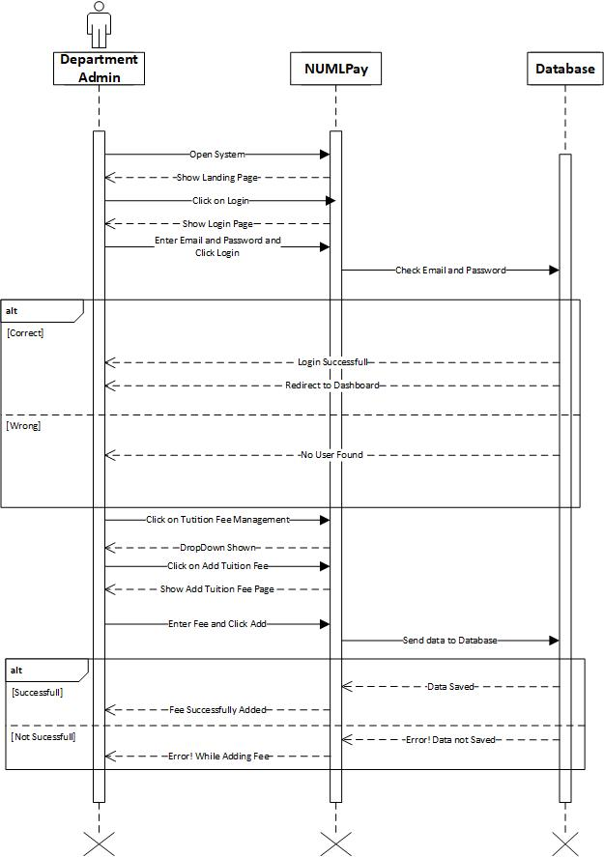
Add Fee Sequence Diagram

Slide 20
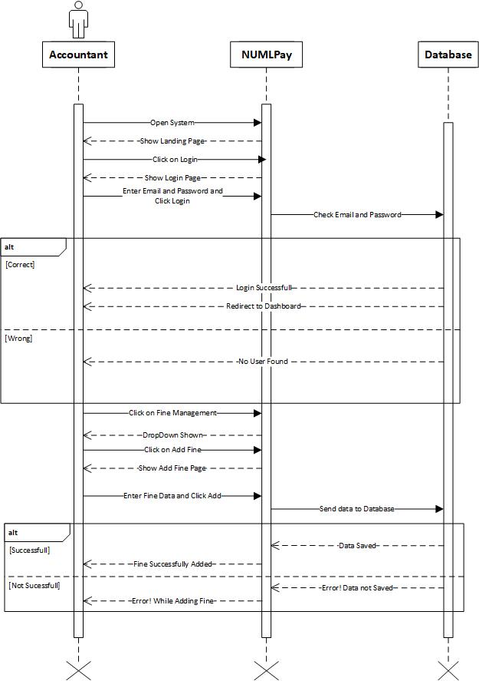
Add Fine Sequence Diagram

Slide 21
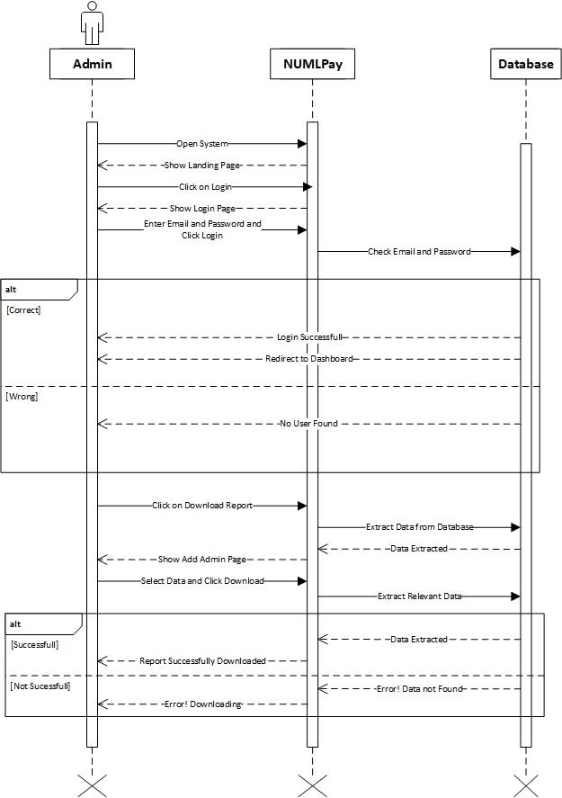
Download Reports Sequence Diagram

Slide 22
Student Verification Sequence Diagram

Slide 23
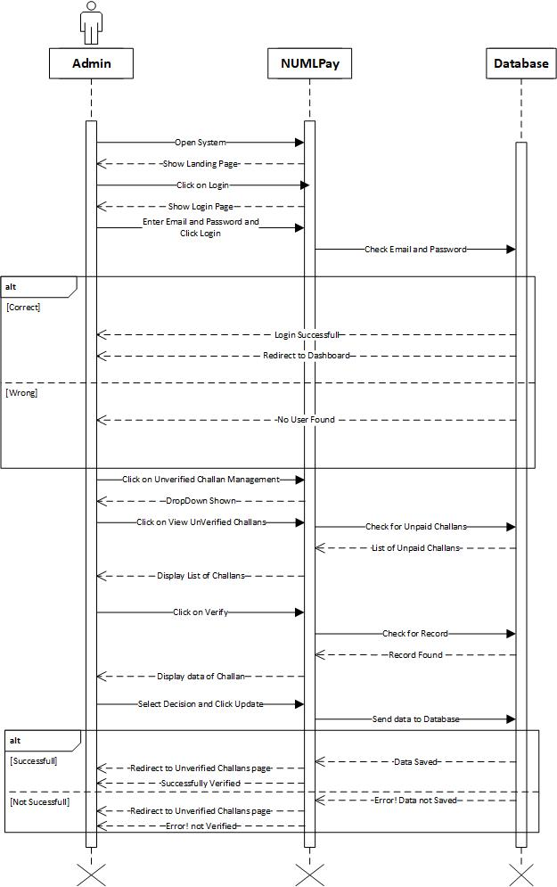
Paid Challan Verification Sequence Diagram

Slide 24
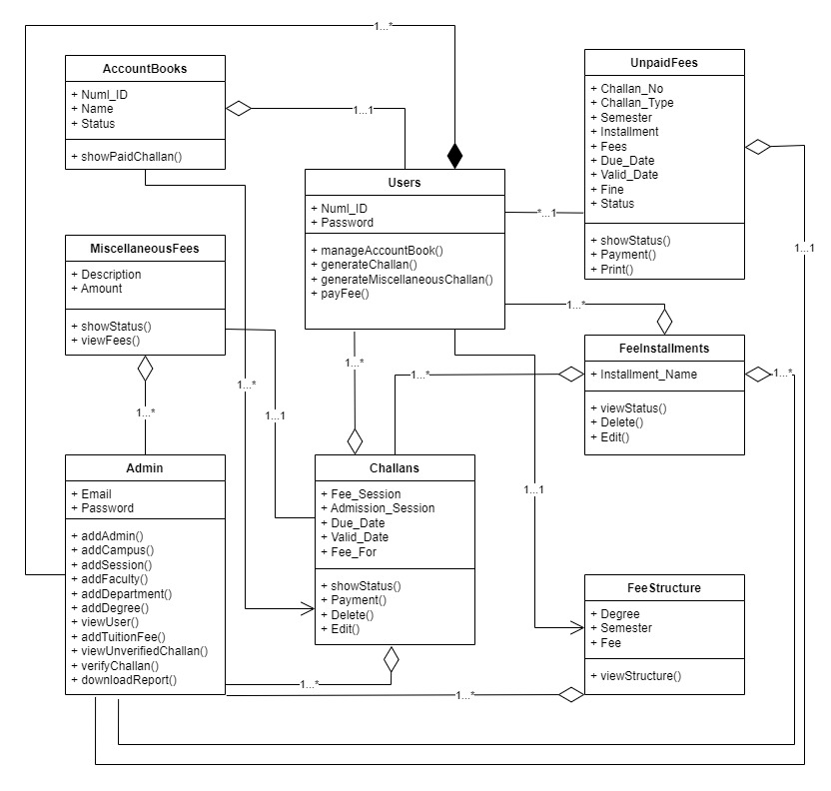
Class Diagram

Slide 25
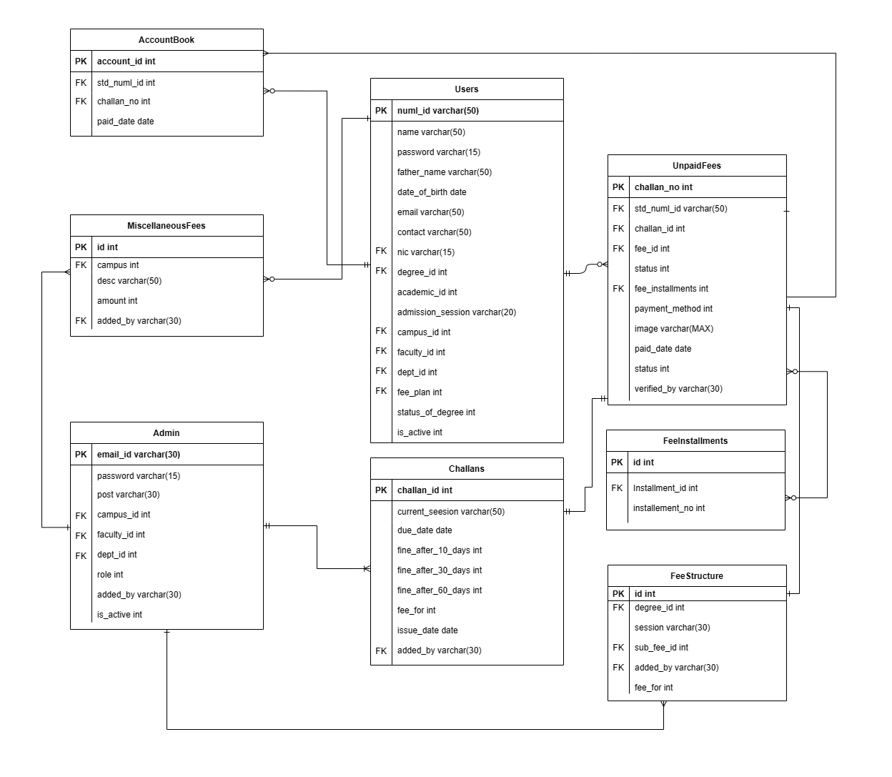
ERD

Slide 26
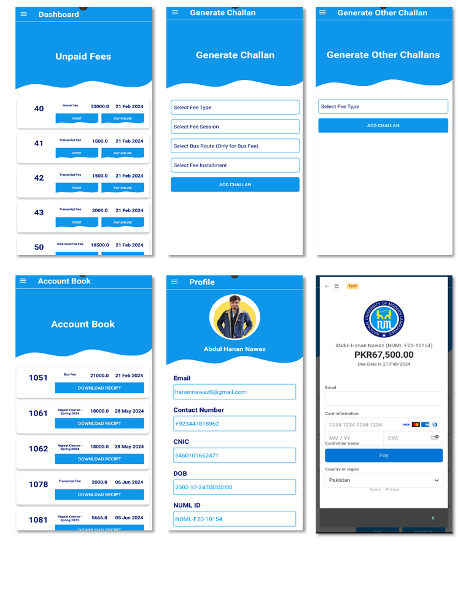
System Android

Slide 27
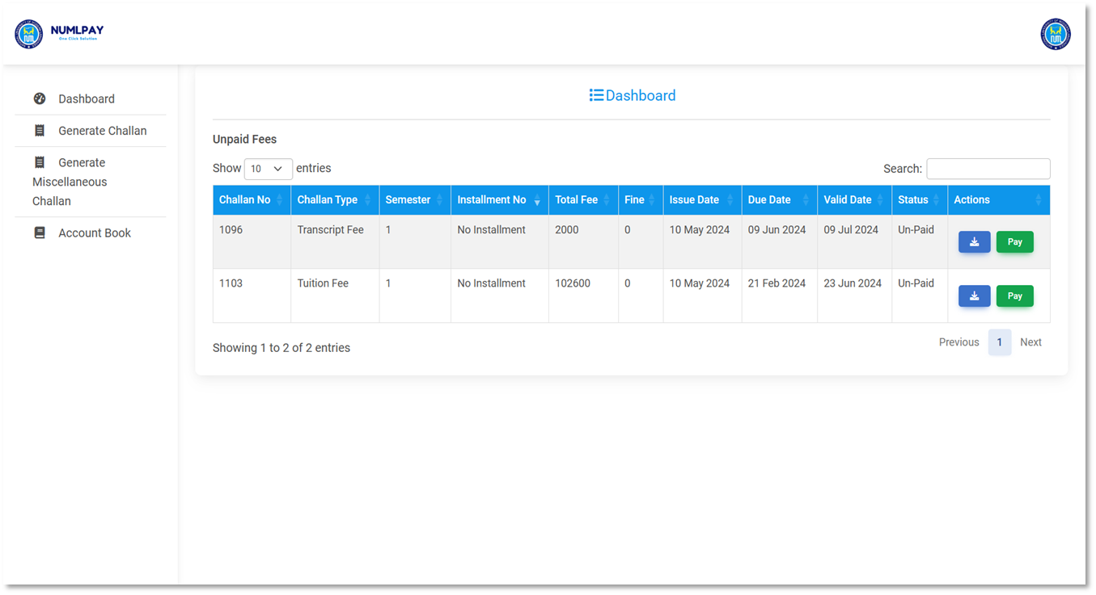
System Web - User

Slide 28
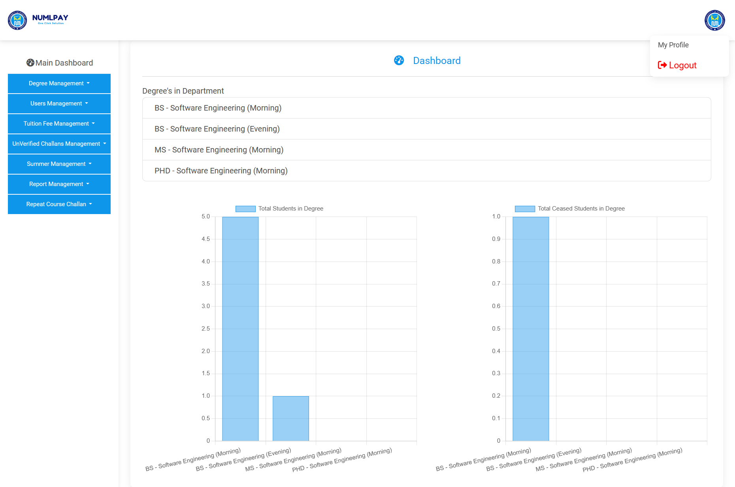
System Web – Dept. Admin

Slide 29
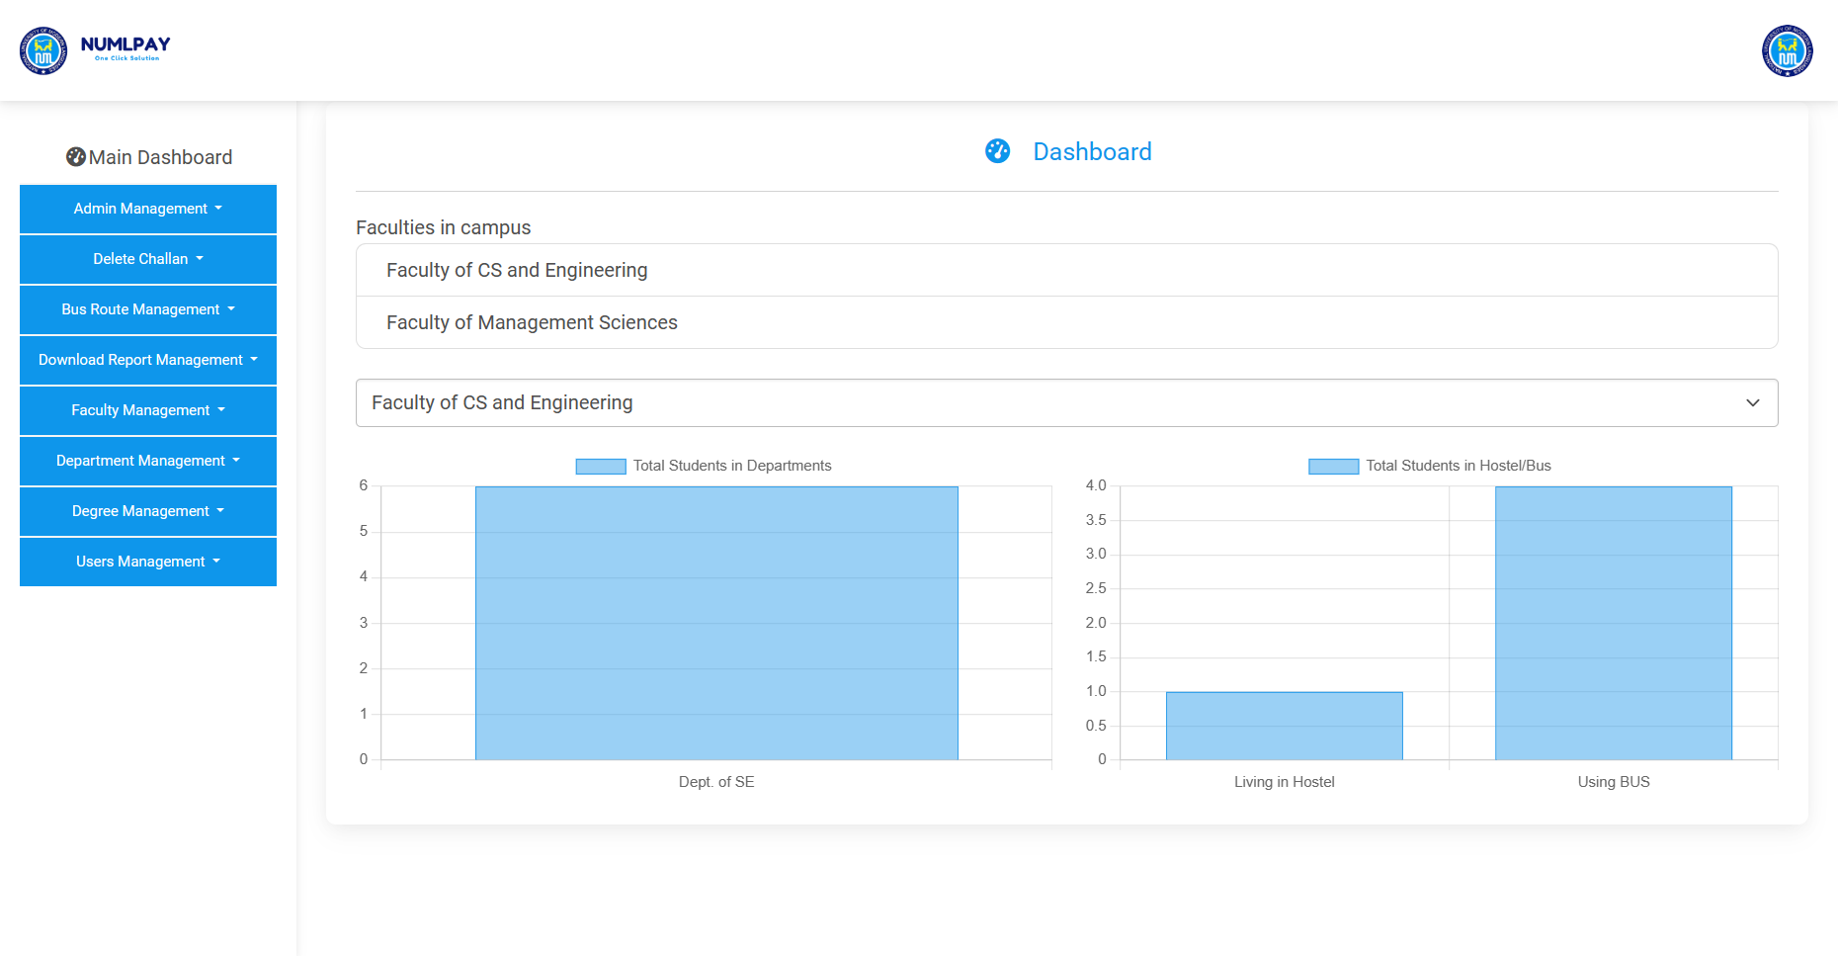
System Web – Campus Admin

Slide 30
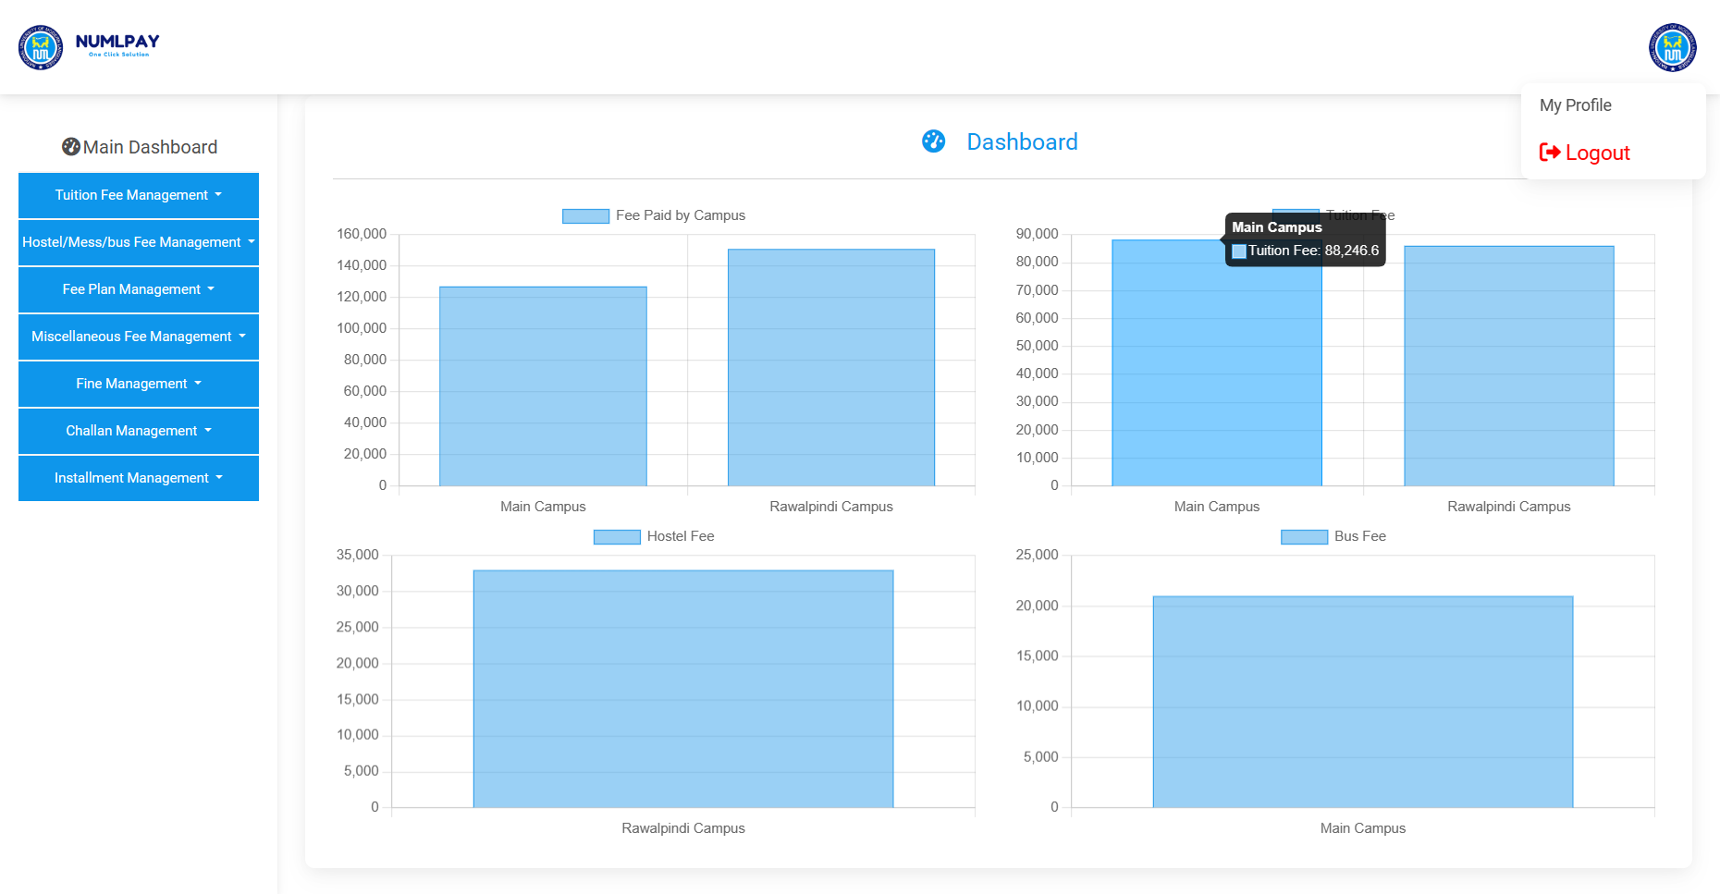
System Web – Accountant Admin

Slide 31
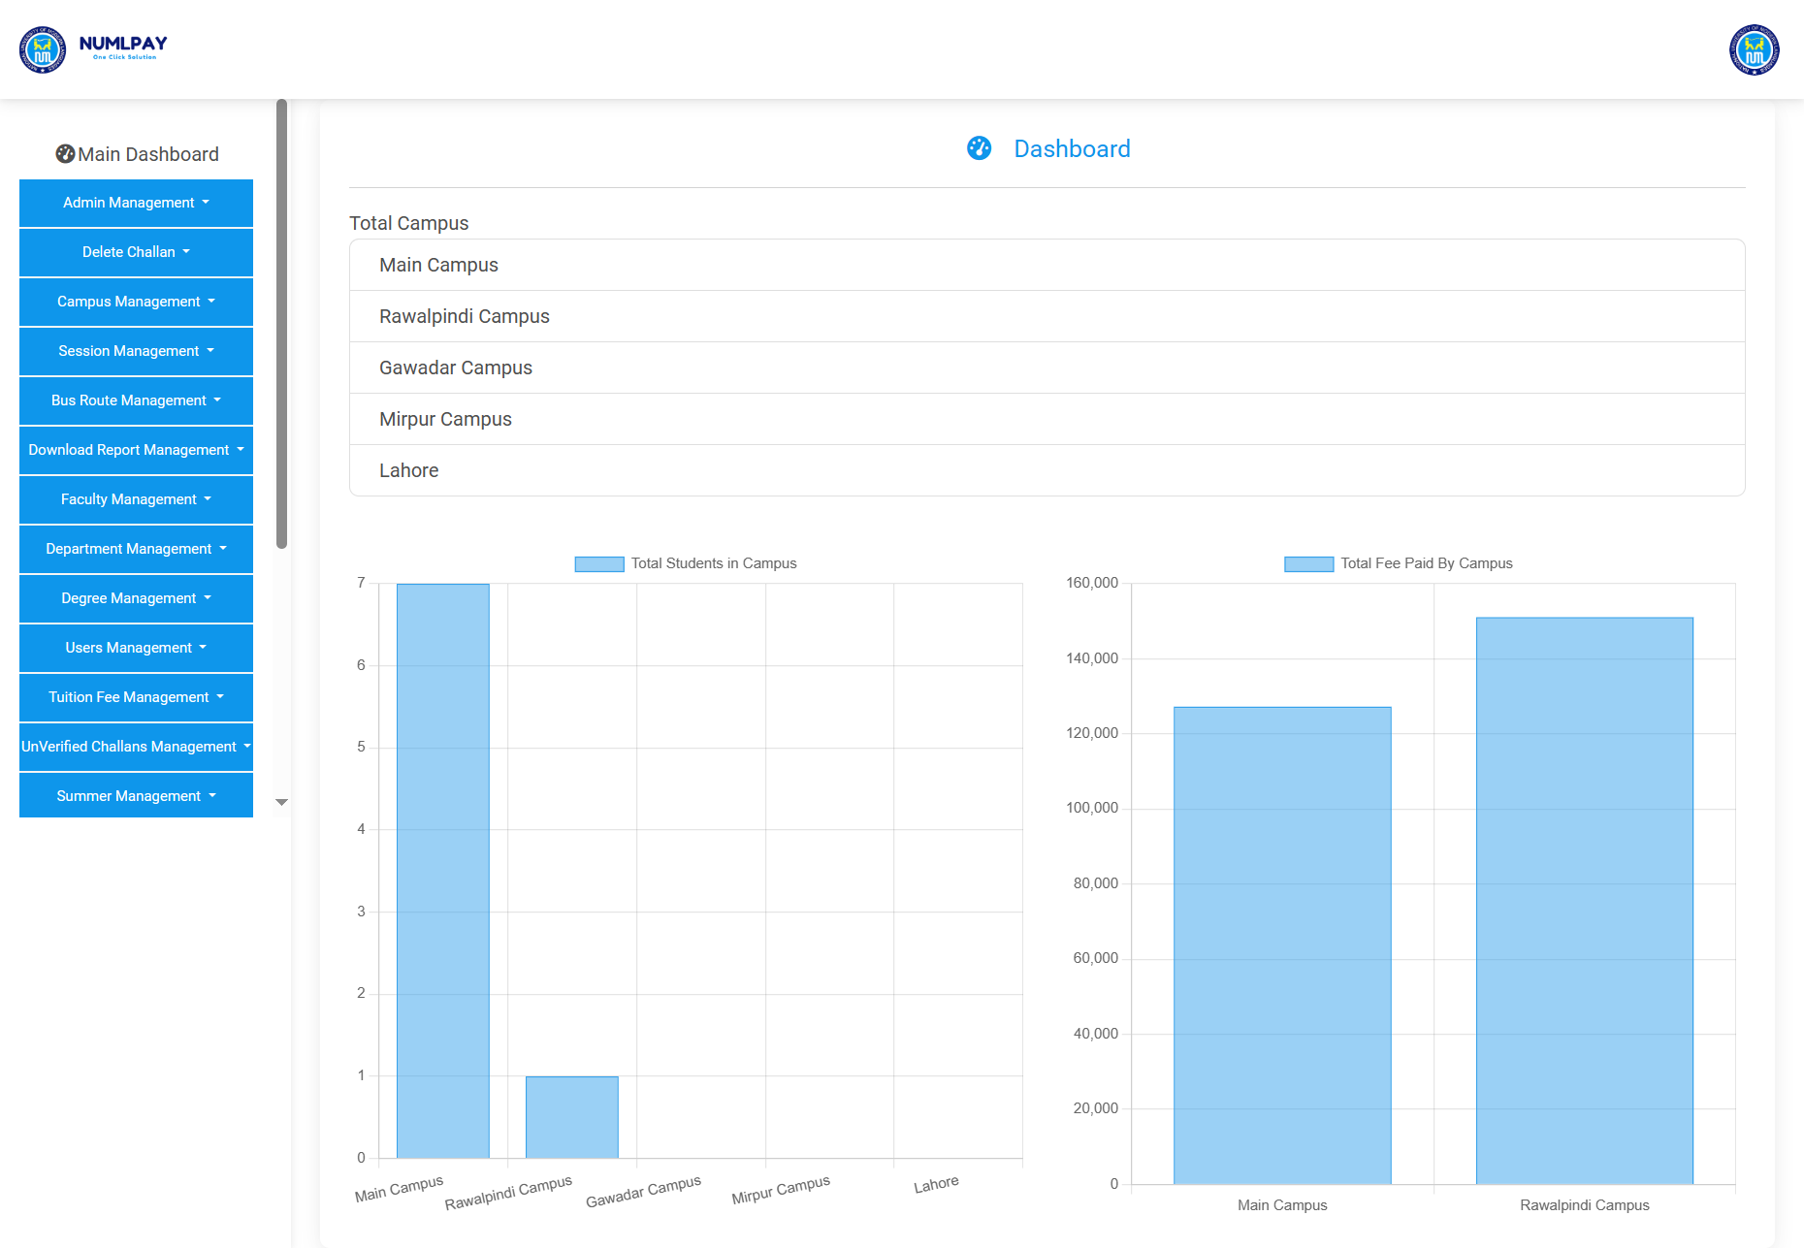
System Web – Super Admin

Slide 32

Any Questions?
“JizakAllah”

